Slide 1
Ticketless Entry System to Monuments/Museums
TEAM MEMBERS:-
GUIDED BY

Slide 2
CONTENTS:
Abstract
Introduction
Problem Statement
Literature Survey
Existing System
Proposed System
System requirements
UML Diagrams
Module Split up
Algorithm
Methodology
Results
References
Conclusion

Slide 3
ABSTRACT
Easing up the process of entry to monuments and museums with the help of a ticketless entry system. It will also help in keeping proper track of people present at the said location, managing proper resources for the people present and preventing fraudulent entries. This application allows organizations and venues to sell tickets in advance and stay within capacity guidelines. It reduces booking expenses by eliminating the need for printing and mailing paper document. It also improves sales as a visitor can book, purchase and print out the electronic ticket any time 24 hours a day. It uses digital modules for access and payment.

Slide 4
INTRODUCTION
The ticketless entry system is the one that works without physical tickets. It reduces the need of hardware equipment. It involves the generation of tickets using QR codes.
The system displays a filtered list of Monuments/Museums on preferred location. All the users can add and view the reviews for each Monument/Museum.
An e-ticket is a paperless electronic document used for ticketing. Users can also enquire about the museums/monuments. Rating them is also incorporated.
Using this system enables us to lines move faster, more visitors are able to enter in a shorter amount of time.

Slide 5
INTRODUCTION
Data gathered from ticket sales enables understanding of type of visitors and purchase patterns. Monuments/Museums owners can then create packages, offers, even exhibits with greater appeal.
The process of entering a museum/monument becomes quick and easy with a scannable quick response ticket.
Admin can conveniently validate the ticket issued by the app and maintain record of the revenue and visitors.
With this app we enable the prediction of incoming crowd on any particular day and suggest the visitors with optimal time slots according to the current crowd present at the moment.

Slide 6
PROBLEM STATEMENT
To develop the ticketless entry system for monuments/museums by generating the e-tickets which consists of QR-code.

Slide 7
LITERATURE SURVEY
SERIAL NO. | AUTHOR NAME | TITLE OF THE PROJECT | TECHNOLOGIES USED | LIMITATIONS
1 | Shailesh Shrivastava | Trouble ticket processing | Machine Learning | Multiple scanning of same ticket.
2 | Prafulla P S, Kalavathi S N Hema K J, Sharath S | Ticketless system using RFID Device | Raspberry PI Python | Security problems, Delay, Inaccuracy.
3 | Ramya R, Prakruthi N, Sahil Bahri, Reshma | Smart ticketing system using barcode | Barcode Scan, Raspberry PI | Less secure, Physical damages leads to less accuracy

Slide 8
LITERATURE SURVEY
y
SERIAL NO. | AUTHOR NAME | TITLE OF THE PROJECT | TECHNOLOGIES USED | LIMITATIONS
4 | Varun Krishna K.G, Selvarathinam s, Ram Kumar R.M | Modified Ticketing System using RFID | Cyclometer coupled to the wheels of bus | Time consuming, malfunctioning
5 | Ayad Mohammed, Shatt Al-Arab | Design and Developing ticketing system by using unified modeling language | PHP, SQL, Ajax, CSS, JavaScript | Usability issues, Security issues.

Slide 9
EXISTING SYSTEM
The existing system is the traditional paper based ticketing system which requires a more number of staff, ticket can be lost or stolen.
This system requires paper which is produced by enormous amount of energy, paper and plants.
It is a time consuming process as manual entry is required.
Visitors need to wait for a long time if there is more crowd.

Slide 10
PROPOSED SYSTEM
To eliminate all these issues ticketless system is required which generates E-ticket with a QR-code on it.
In this application user can fill the required details, make payment and book tickets. As the next step ticket is generated with a QR-code.
With this app we enable the prediction of incoming crowd on any particular day and suggest the visitors with optimal time slots.

Slide 11
SYSTEM REQUIREMENTS
Software Configuration:
Language: Python
Operating System: Windows
Front end: Flutter
Back end: Firebase
Hardware Configuration:
System: i3 or high processor
Monitor: Standard LED monitor
Input devices:
Power Supply Cable
RAM:16 GB

Slide 12
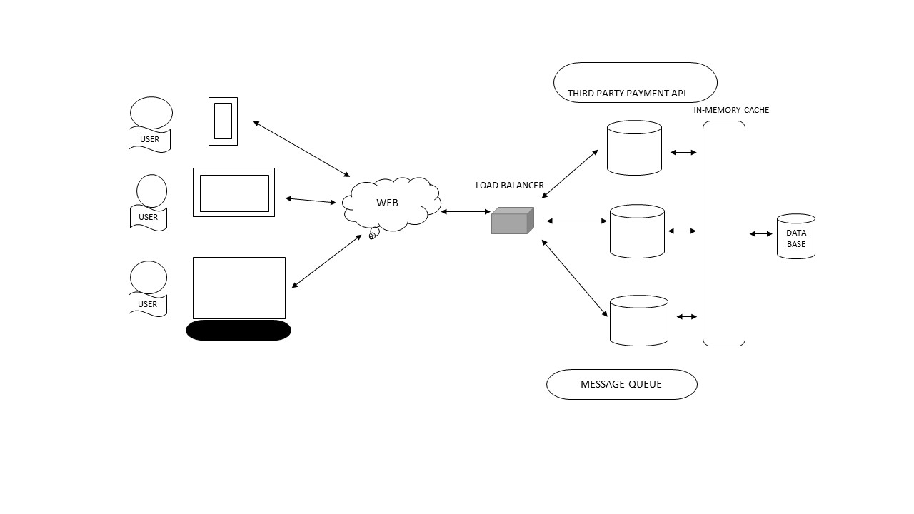
ARCHITECTURE

Slide 13
UML DIAGRAMS
Data flow Diagram
Class Diagram
Use case Diagram
Activity Diagram
Sequence Diagram

Slide 14
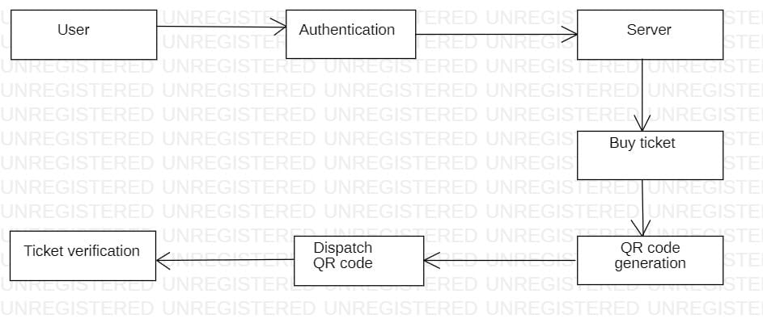
DATAFLOW DIAGRAM

Slide 15
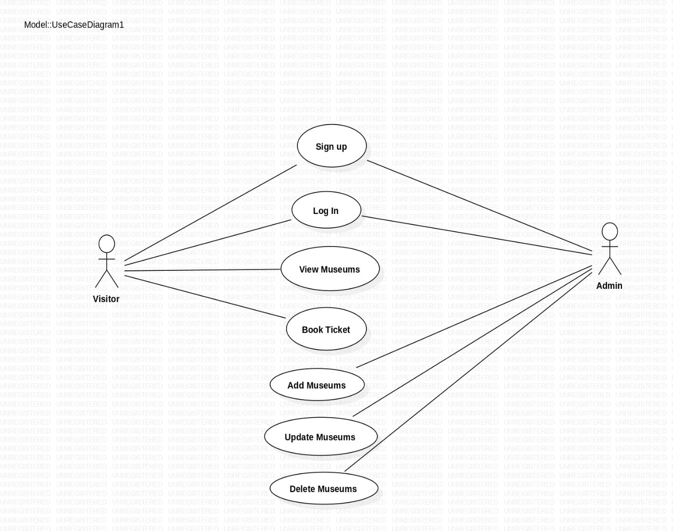
USE CASE DIAGRAM

Slide 16
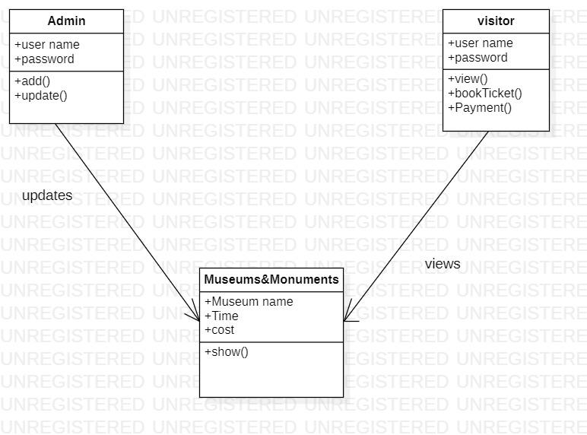
CLASS DIAGRAM

Slide 17
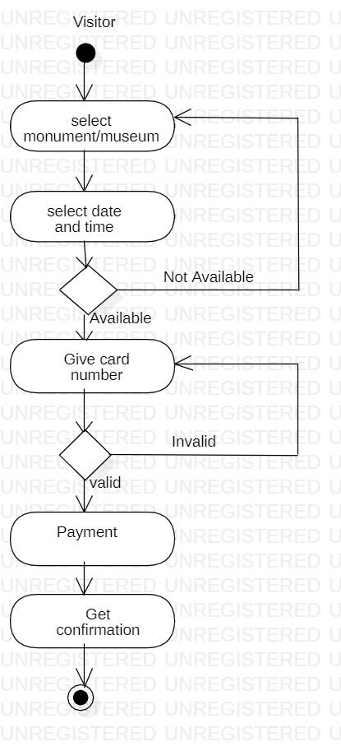
ACTIVITY DIAGRAM

Slide 18
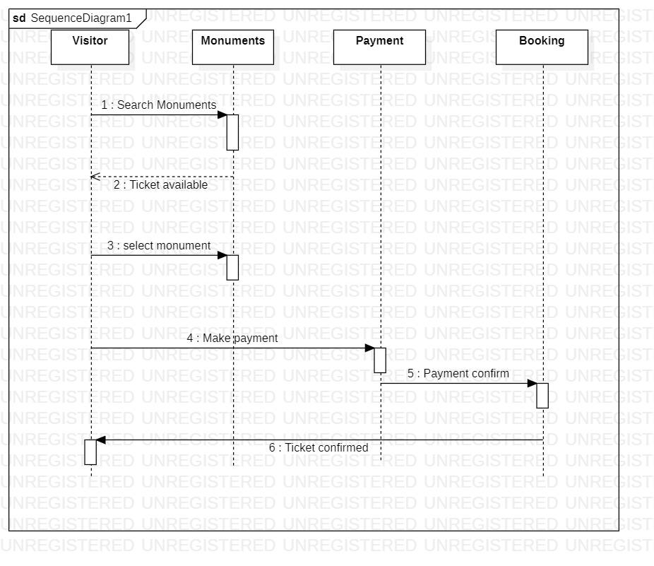
SEQUENCE DIAGRAM

Slide 19
MODULE SPLITUP
1. LOG IN
The visitor need to log into the application to book their ticket to monument or museum. Both admin and visitor has a common login page which are based on their role. To log in, a visitor need to enter his/her email and password. If the provided credentials are correct, the user will be logged in and further operations can be performed. Visitor can also log in directly by sign in with google option.
2. CHOOSE MONUMENTS/MUSEUMS
This module consists of various information about the monuments and museums. After logging successfully visitor can view the various monuments. This module consists of images of every monument, description, price, location, ratings and reviews.

Slide 20
3. ADD BOOKING INFORMATION
After choosing a particular monument or museum the visitor need to enter the details like name of the visitor, number of adults, number of children and need to select the date. Visitor can also choose the preferred slot time. Based on the timings discount are also shown in this module. After entering all the details visitor need to make payment.
4. DISPLAYING TICKET
This module displays the booked ticket after successful payment. It consists of details entered by visitor and also QR code.
5. SCANNING TICKET
Admin need to log in to the app with his credentials. The ticket shown by the visitors are scanned by admin to let visitors enter the monument or museum after successful scanning of ticket. When admin scans the ticket it shows message like ticket is successfully scanned.
6. LOG OUT
It is the common module for admin and visitor and can be logged out using this.

Slide 21
ALGORITHM
Reed Solomon:
Determine the input data: The input data is a sequence of symbols that need to be encoded into a QR code.
Choose the desired parameters: Determine the parameters for the Reed-Solomon code, including the number of error correction codewords (ECC), the number of data codewords, and the desired error correction level. These parameters depend on the specific QR code version and error correction level chosen.
Calculate the number of error correction codewords (ECC): Based on the chosen parameters, calculate the number of error correction codewords to be added to the input data. The more error correction codewords, the higher the error correction capability of the QR code.
Generate the message polynomial: Treat the input data as coefficients of a polynomial. For example, if the input data is [1, 2, 3], it represents the polynomial f(x) = 1x^2 + 2x + 3.

Slide 22
Generate the generator polynomial: The generator polynomial is a fixed polynomial based on the chosen parameters. It is constructed to generate the error correction codewords. The generator polynomial is usually represented as a binary number.
Perform polynomial division: Divide the message polynomial by the generator polynomial using polynomial long division. The result is the quotient polynomial and the remainder polynomial. The remainder polynomial represents the error correction codewords.
Encode the error correction codewords: Convert the coefficients of the remainder polynomial into a sequence of symbols according to the chosen QR code's error correction level. These symbols are then added to the input data, forming the final encoded data.
Construct the QR code matrix: Map the encoded data onto a grid to form the QR code matrix. Each symbol is represented by a black or white module in the matrix.
Apply masking patterns: Apply predefined masking patterns to the QR code matrix to improve readability and prevent decoding errors. Masking alters the appearance of the QR code by flipping certain modules based on the masking pattern.

Slide 23
Construct the QR code matrix: Map the encoded data onto a grid to form the QR code matrix. Each symbol is represented by a black or white module in the matrix.
Apply masking patterns: Apply predefined masking patterns to the QR code matrix to improve readability and prevent decoding errors. Masking alters the appearance of the QR code by flipping certain modules based on the masking pattern.

Slide 24
METHODOLOGY
Requirements Gathering: Understand the specific requirements of the ticketless entry system, including features, user flows, and any additional functionalities needed.
System Design: Plan the architecture and design of the application. Consider the components, data flow, and integration with Firebase for authentication and data storage.
Set up Firebase Project: Create a new project in Firebase and configure the necessary services like Firebase Authentication and Firebase Cloud Firestore for data storage.
User Authentication: Implement user authentication using Firebase Authentication. Users can sign up, log in, and log out using email/password, or google.
Database Schema Design: Design the database schema to store relevant information such as museums, bookings, and user data. Create collections and documents in Firebase Cloud Firestore accordingly.
QR Code Generation: Use a Flutter package to generate QR codes. Flutter has several packages available, such as qr_flutter. Generate unique QR codes for each user or booking.

Slide 25
METHODOLOGY(contd.)
Flutter App Development: Develop the front end using Flutter. Create screens for user registration, login, museum/monument listings, booking details, and the QR code scanning screen. Integrate the QR code generator package to display the generated QR code.
Firebase Integration: Connect the Flutter app to Firebase. Use the Firebase SDKs to authenticate users, retrieve and store data in Firestore, and perform necessary operations like creating bookings and updating user information.
Booking Process: Implement the booking process flow. Users should be able to select museums or monuments, choose time slots, and complete the booking by providing necessary details.
QR Code Validation: Create a QR code scanner screen in Flutter using a package like barcode_scan to validate the QR code at the entrance. Scan the QR code and verify it against the stored data in Firestore.
Testing and Debugging: Perform extensive testing to ensure the system functions properly. Test different scenarios, edge cases, and user flows to identify and fix any bugs or issues.

Slide 26
Sign In Page
This page allows the visitor or admin to sign in to the application using login credentials like email and password.
Sign Up Page
This page allows the visitor to create an account by entering the required data. The user need to choose whether they are admin or visitor and enter their email address and choose a password.
Technologies used
Flutter
Firebase

Slide 27
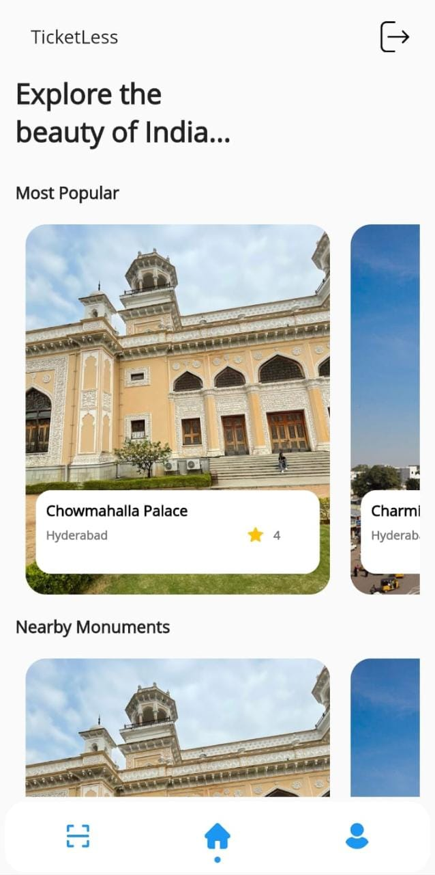
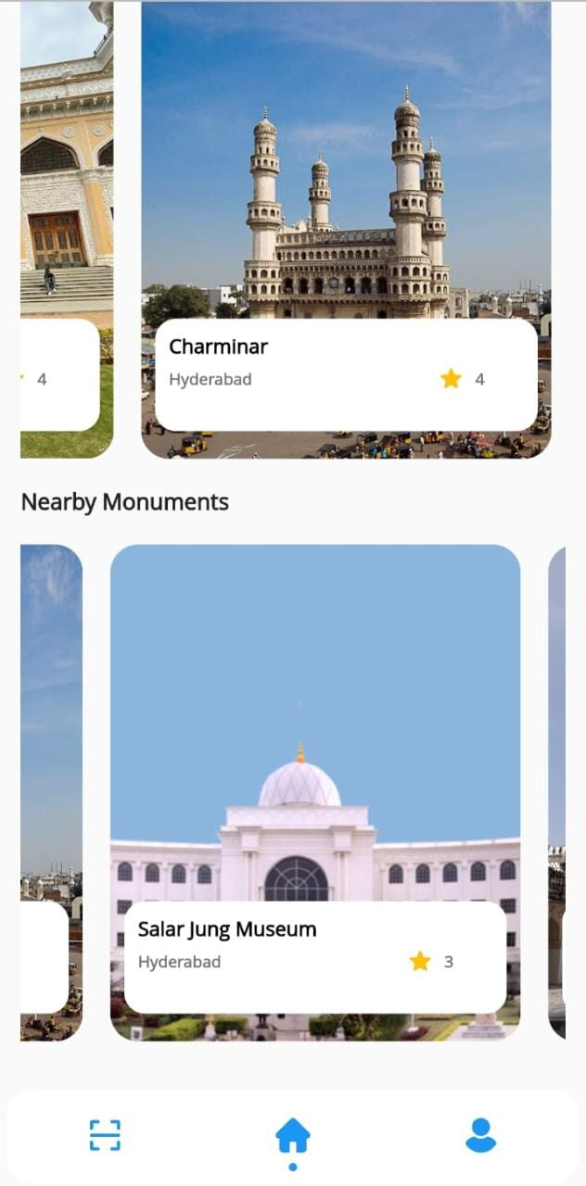
RESULTS
Monument/Museum selection

Slide 28
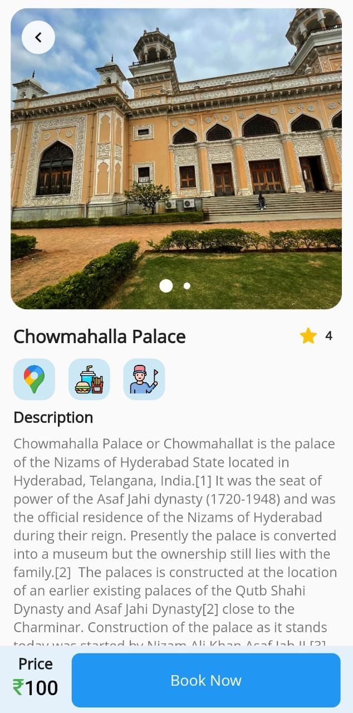
Monument/museum information

Slide 29
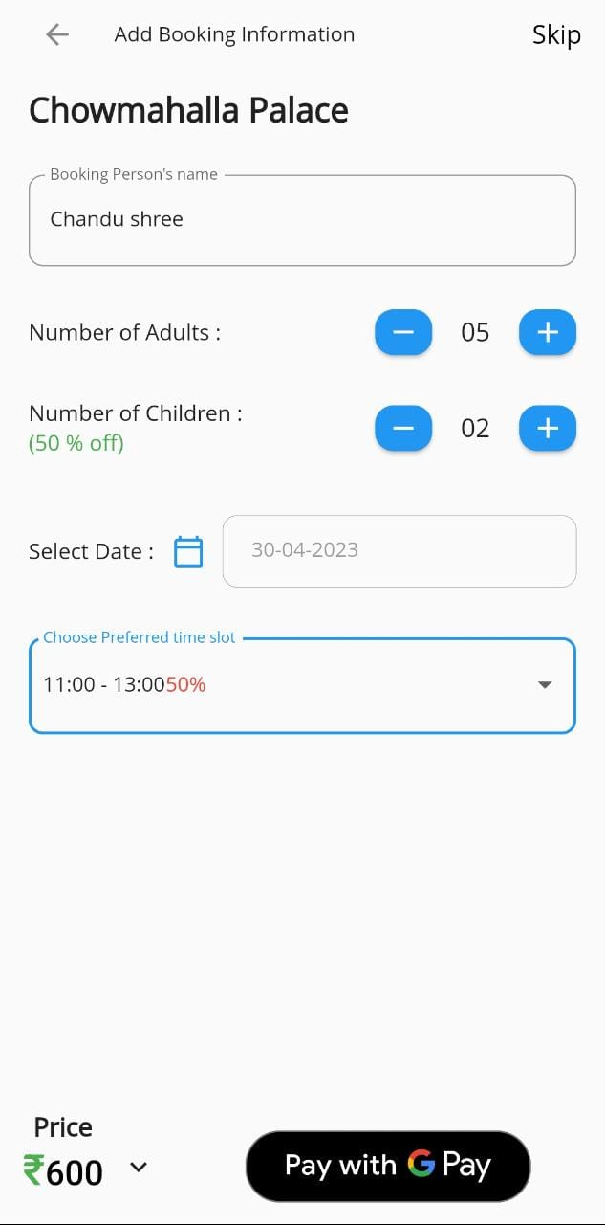
Ticket Booking Process

Slide 30
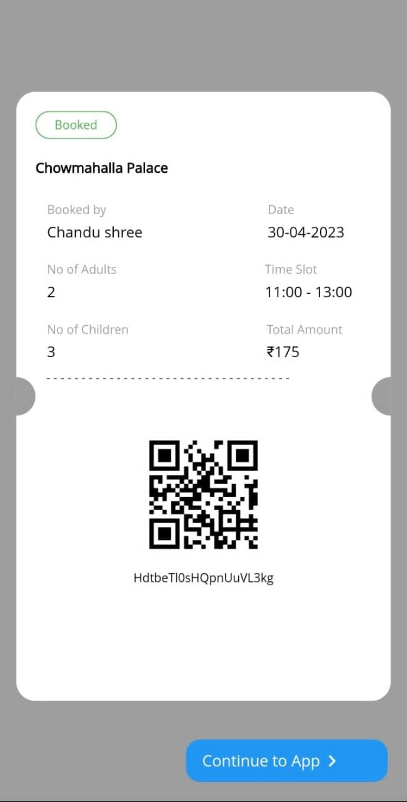
Booked Ticket

Slide 31
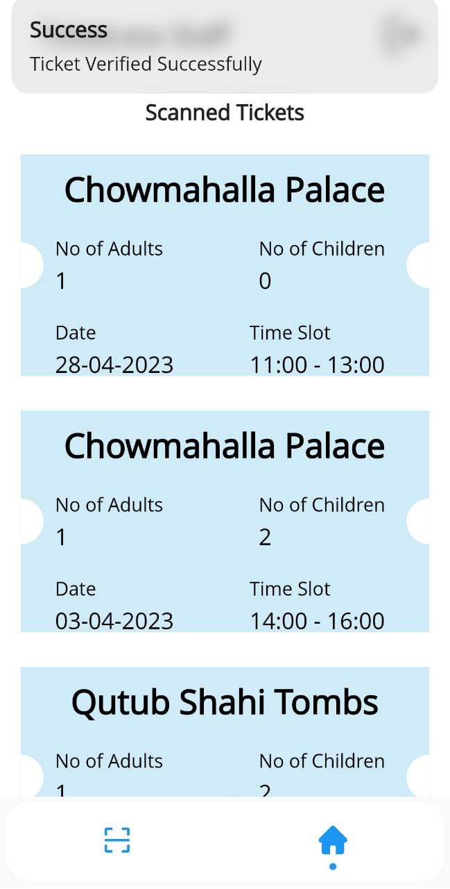
List of Tickets Scanned by Admin

Slide 32
REFERENCES
Shailesh Shrivastava,” Trouble ticket processing” in, India,2018.
Prafulla P S, Kalavathi S N, Hema K J, and Sharath S,” Ticketless system using RFID Device” in, India, 2018.
Ramya R, Prakruthi N, Sahil Bahri, Reshma,” Smart ticketing system using barcode”in, Bangalore India, 2019.
Varun Krishna K.G, Selvarathinam s, Ram Kumar R.M,” Modified Ticketing System using RFID” in,
Ayad Mohammed, Shatt Al-Arab,” Design and Developing ticketing system by using unified modeling language” in, Iraq, 2019.

Slide 33
CONCLUSION
We have designed an application which eases up the entry to the monuments/museums based on QR code technology. It reduces the paper waste and enhance visitor experience and embrace technological advancements.

Slide 34

THANK YOU

